Slide 1
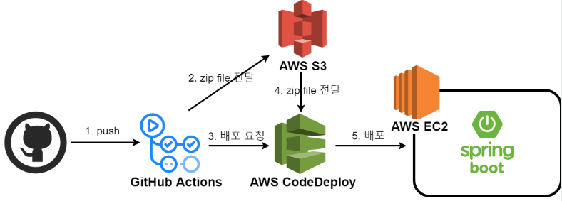
(AmazonS3FullAcess)
(AWSCodeDeployFullAccess)
(AmazonS3FullAcess)

